Slide 1







TECHNOLOGY TREND VS JOB AVAILABILITY ANALYSIS
Sudhakar Ceemavaram Nandhakumar
September/28/2021

Slide 2



OUTLINE
Executive Summary
Introduction
Methodology
Results
Visualization – Charts
Dashboard
Discussion
Findings & Implications
Conclusion
Appendix

Slide 3

EXECUTIVE SUMMARY
From the charts we can conclude development of Web-application using javascript and React js sure have a bright future.
But in contrast, more jobs are available for C developers.
Notes:
Contains the conclusion -> write at last

Slide 4

INTRODUCTION
Dataset used -> Stack overflow annual developer survey 2019.
The survey collects the information such as favorite language, technology, database etc. from the coders all over the globe.
This data will be useful in determining the reason behind the growth or fall of the technology/language.
The survey also collected the demographic data about the coders, which will be useful in filtering the technology’s growth in a specific region or familiarity of the technology within certain age group.
Different visualization charts were used to decapsulate the insights from the data provided. The dashboards and the conclusion are on the following slides.
Notes:
Dataset used -> Stack overflow annual developer survey 2019.
The survey collects the information such as favorite language, technology, database etc. from the coders all over the globe.
This data will be useful in determining the reason behind the growth or fall of the technology/language.
The survey also collected the demographic data about the coders, which will be useful in filtering the technology’s growth in a specific region or familiarity of the technology within certain age group.
Different visualization charts were used to decapsulate the insights from the data provided. The dashboards and the conclusion are on the following slides.

Slide 5

METHODOLOGY
The analysis is done on technologies in the trend vs. their respective job opportunities in 2019.
Stack Overflow Survey 2019 and Github job openings dataset is used.
The pre-processing of data and the statistical analysis are done use python.
Pandas, Numpy and Seaborn were the libraries used for statistical analysis.
IBM Watson Studio is used to create the Dashboards.

Slide 6
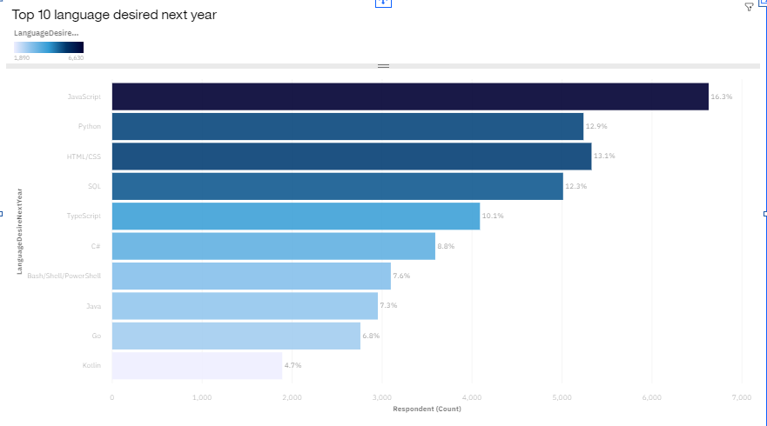
RESULT
As per the plots, it is evident that the most desired language to learn is JavaScript, but the most available job opportunity is for C programming.

Slide 7
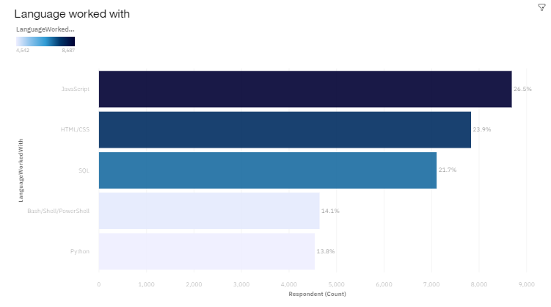
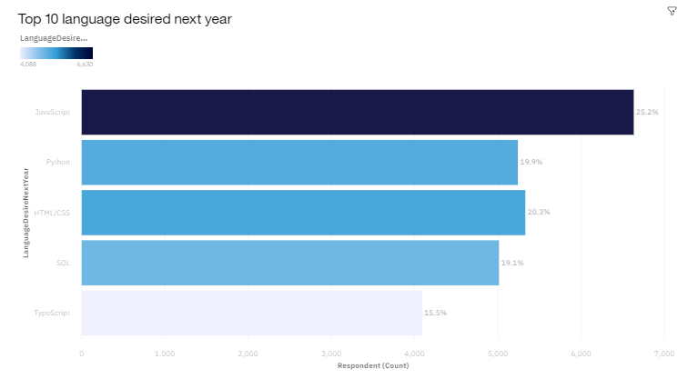
PROGRAMMING LANGUAGE TRENDS
Current Year
Next Year

Slide 8
PROGRAMMING LANGUAGE TRENDS - FINDINGS & IMPLICATIONS
Findings
Javascript and HTML occupies the top two positions on the current and the next year chart.
JS and HTML -> Determines more respondents are interested in Webapp development.
Python gained interests in the upcoming year.
The familiarity of SQL remains the same.
Implications
Typescript replacing Powershell confirms the high interest towards Web application development.
Improvement in python and SQL shows the gradual increase in ML and Data Science.
JAVA’s familiarity almost remained the same in both the plots, stating its evergreen capability.

Slide 9
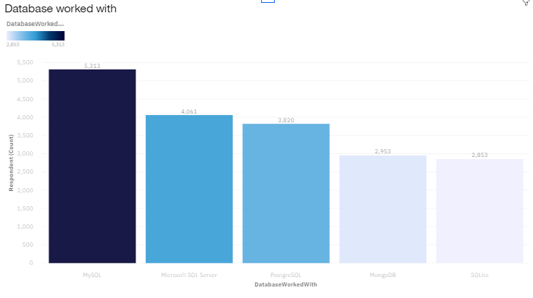
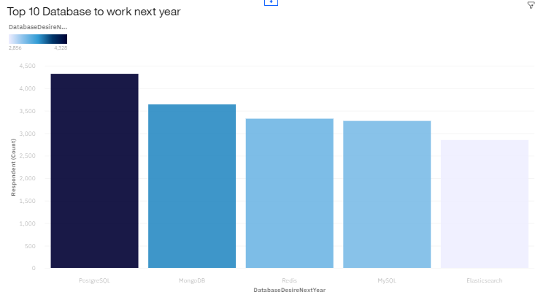
DATABASE TRENDS
Current Year
Next Year

Slide 10
DATABASE TRENDS - FINDINGS & IMPLICATIONS
Findings
MySQL and Postgre SQL occupies the top position in the current and the next year chart.
Microsoft SQL and Sqlite ruled out of the top 5 DB list.
Elastic search got into the top 5 databases list.
Implications
Postgre SQL and Mongo DB gained sudden interest in the upcoming year.
MySQL lost its spot on the next year, since not many respondents are willing to learn, which might imply that it’s already well spread and currently in use by many respondents like the 1st chart states.
The usage of Sqlite imply the development of small-scale projects and the usage of python.

Slide 11

DASHBOARD
https://dataplatform.cloud.ibm.com/dashboards/d6adeaa3-7553-4870-8c7e-3cedd4362c2f/view/7207c0263ab30d8d67b4f6e407987a062b63200fb4bb850681d37b490b627797f0691298c82f1959d3450336f4b8105bc1

Slide 12
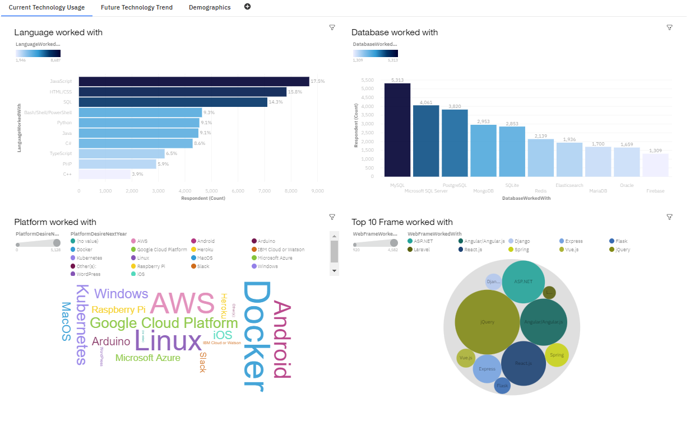
DASHBOARD TAB 1

Slide 13
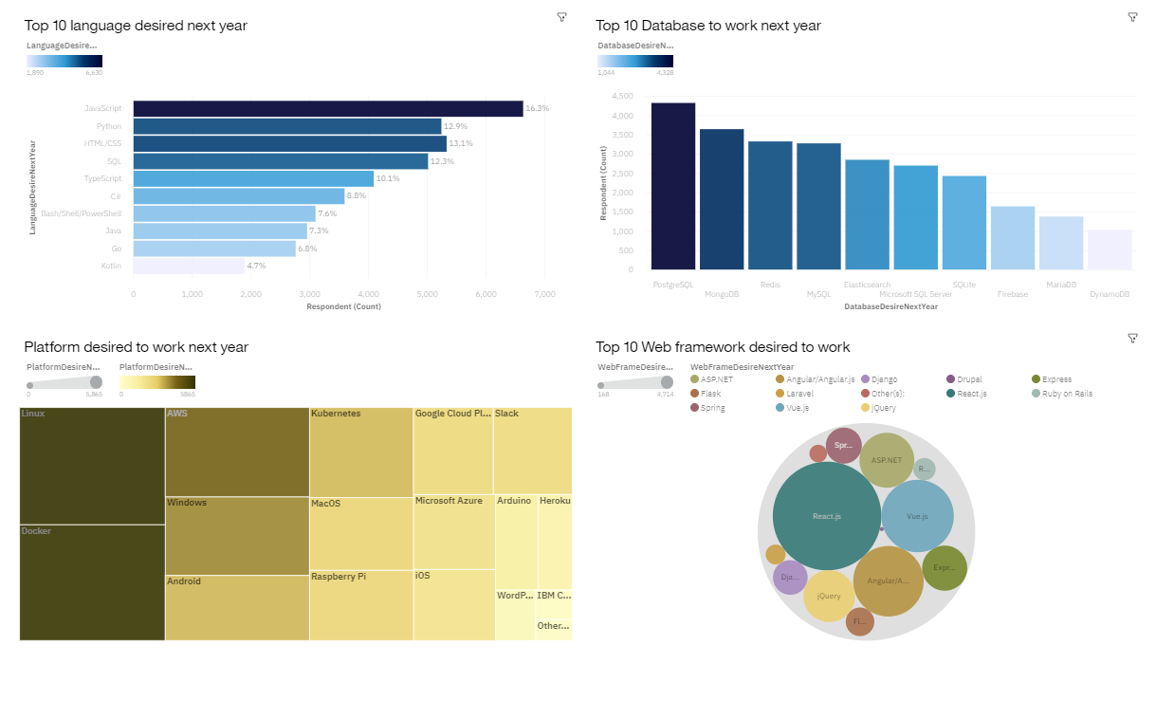
DASHBOARD TAB 2

Slide 14
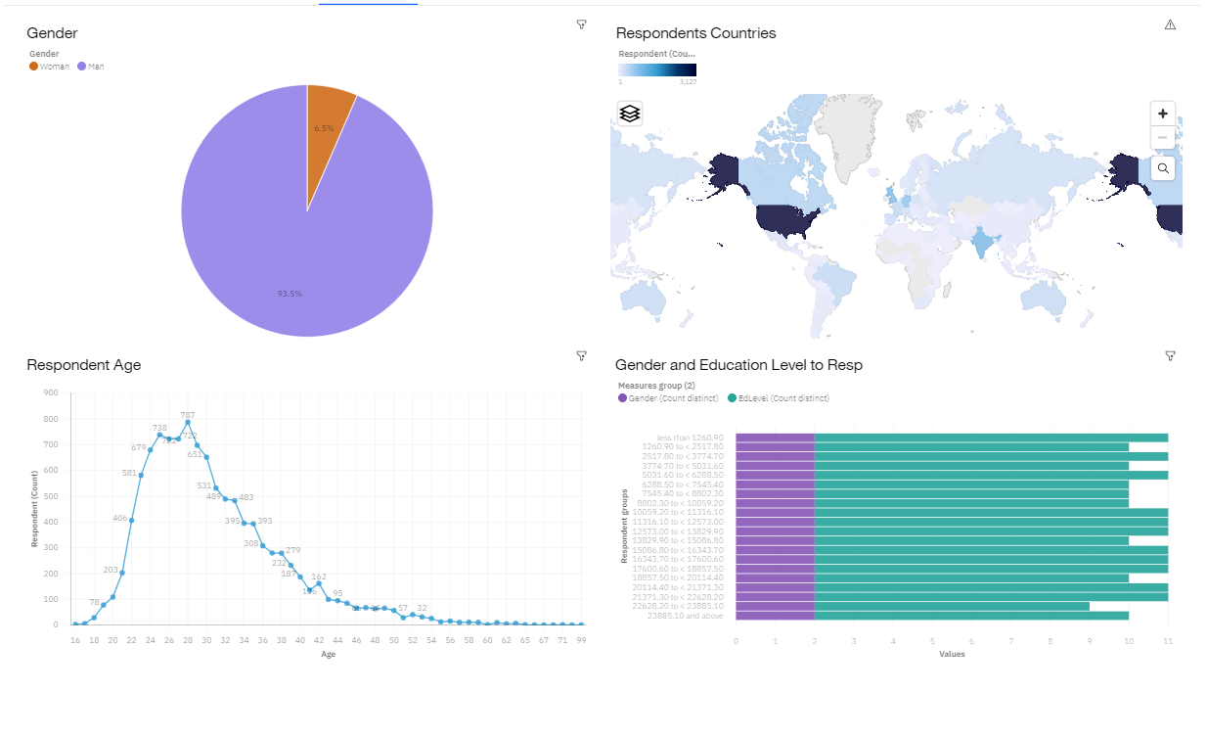
DASHBOARD TAB 3

Slide 15
DISCUSSION
The dashboard 1 consist of the technologies the respondents were working on currently.
The dashboard 2 consists of the technologies the respondents desired to learn the next year.
As comparing the two dashboards the percentage of the technologies were changed little but the technologies were almost similar.
It is explicitly shown more respondents were interested to learn Javascript.
The dashboard 3 consist of demographic study of the respondents.
From the survey most of the respondents are from the age group 25 – 35
And most of the respondents belong to United States.
From the charts we can conclude development of Web-application using javascript and React js sure have a bright future.

Slide 16
OVERALL FINDINGS & IMPLICATIONS
Findings
More respondents are currently working and desired to learn Javascript, React js, AWS and MySQL.
Most of the respondents belong to the United States region.
The job postings does not coincide with the findings. Unlikely, C have more job opportunities, but many respondents are interested to learn Javascript.
From the salary plot, Swift developers are provided my higher salary implying the growth of Apple Inc.
Implications
From the charts we can conclude development of Web-application using javascript and React js sure have a bright future.
This statistic report is only true for United States and some part of Asia.
Since the respondent's demographic data were skewed towards specific region, age group and gender, the above conclusion might not be the generalized one.
Considering all the plots, Data Science and ML have high opportunity in the future.

Slide 17

CONCLUSION
The respondent's demographic data were skewed towards specific region and gender, the conclusion might not be the generalized one.
From the dashboards we can conclude many are interested towards web-application development (JavaScript).
Unfortunately, Job openings for JavaScript development are low since the field is already well developed.
Considering all the plots we can conclude,
Web-application/Python development is a high paying field with low opportunity.
C development have a lot of openings. Also, the high interest towards Docker and Linux indicating the improvement in hardware development.
Considering Programming language, Technology and Database plots, ML/Data Science has wide range of opportunities.

Slide 18
GITHUB JOB POSTINGS

Slide 19
POPULAR LANGUAGES

